Slide 1
Welcome to Amazon Clone
A Presentation by
[ Suraj Mishra ]
[Saurabh Rai]
[Vipin Kumar]
[Vipin Maurya]
Submitted To: Hemant Sir

Slide 2
Overview
Introduction to the Amazon Clone

Slide 3
Features
1. User-friendly interface
2. Product search and browsing
3. Secure payment options
4. Order tracking and history
5. Customer support

Slide 4
User Registration
1. Users can register using email or social media accounts.
2. Verify email address for security.
3. Personalized user profiles.

Slide 5
introduction
Amazon Clone be a prime example of an internet site with all the key parts creating up a decent e-commerce website. Businesses, in any field have tons of competition. They're constantly on the lookout for a proven because of increase Revenue. If the business doesn’t have an e-commerce website, they're deed money on the table. The e-commerce web site of Amazonas at first place in conjunction with easy hypertext mark-up language, CSS & JAVASCRIPT. Through this Project, We’ll discover the simplest way to create a useful clone of Amazon e-commerce web site with HTML, CSS and JS. Cloud Computing has become the essential requirement for the IT companies. Cloud Industry is growing at a very good pace, and providing essential services i.e. infrastructure as a service (IaaS), network as a service (NaaS), platform as a service (PaaS) (SaaS). Because of important cost saving several smaller and medium sized organizations are trying forward for exploitation cloud services. The emerging demand for cloud services is driven by continuing globalization, consumer acceptance of technology, economic downturn and the growth of the extended enterprise. Cloud Computing enables many organizations to limit the large capital investment that is associated with costly data centres and for the applications and transforming these costs into operating expenses paying for cloud resources only as required.

Slide 6
Working
Primary Goals: Create header/navigation bar to navigate between pages. Create a home page to display products. Create a login page for user login. Add functionalities like basket, 5 payment and authentication login. Now we’ve our react project dead setup. Now we can start making the amazon clone.
Home page: We are going to use a package for icons, and we need Material Icons to use them. So open your terminal and write the subsequent command.
Add to Cart: It makes the products add in the cart to proceed the checkout function.
Order Tracking: User can track the delivery date.
Payment Option: User can proceed the payout using PayPal and Debit Card Option.

Slide 7
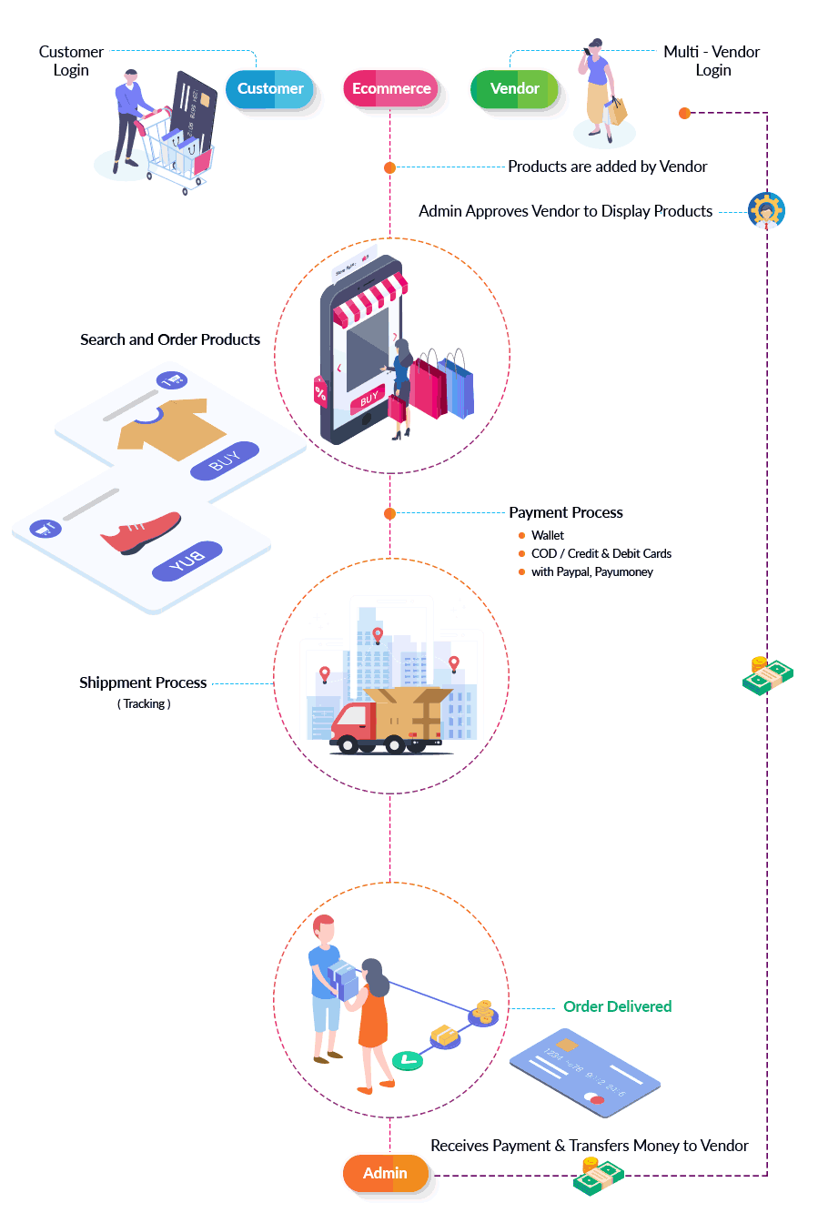
Workflow

Slide 8
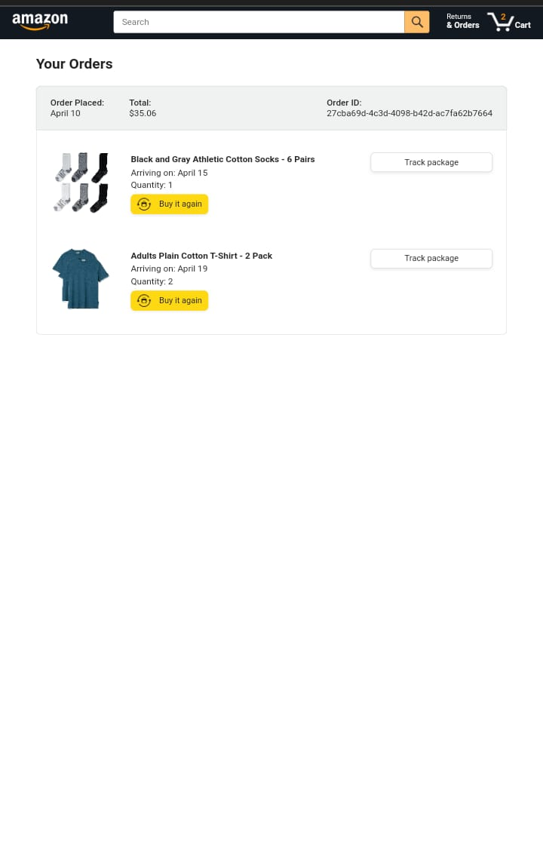
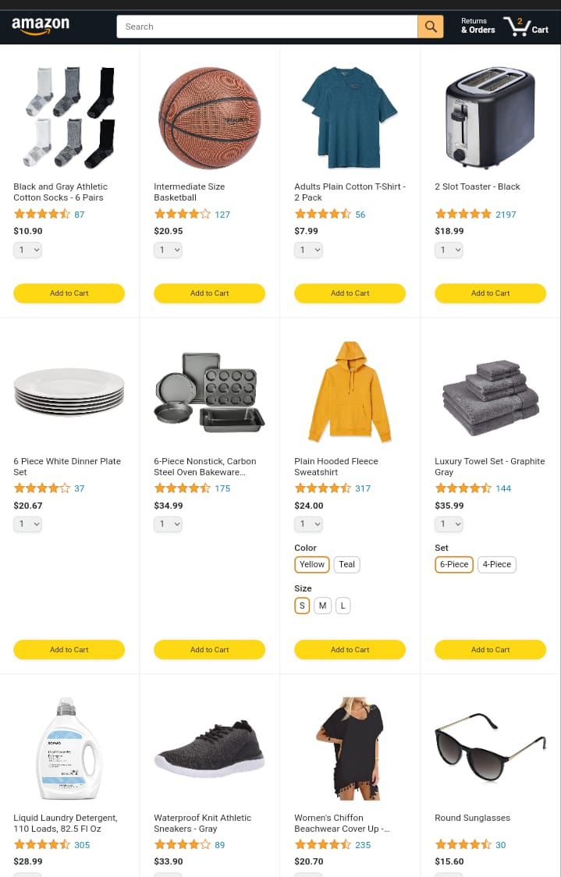
HOMEPAGE
ORDERS

Slide 9
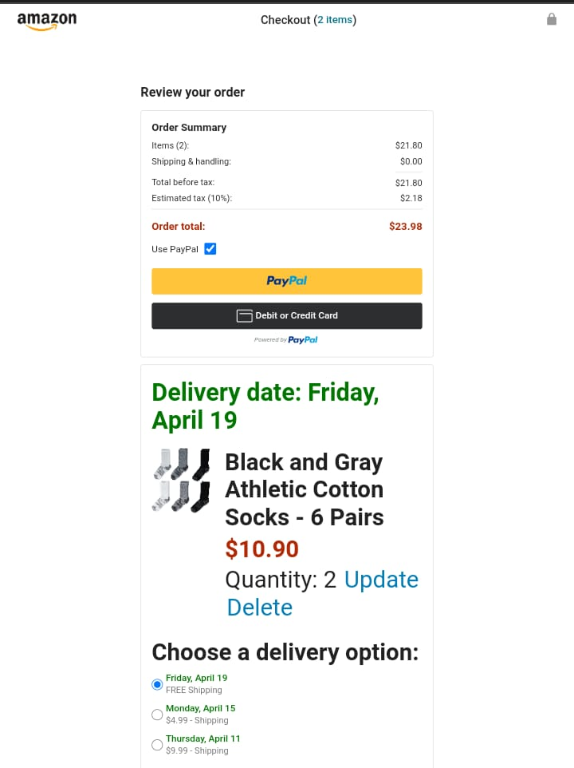
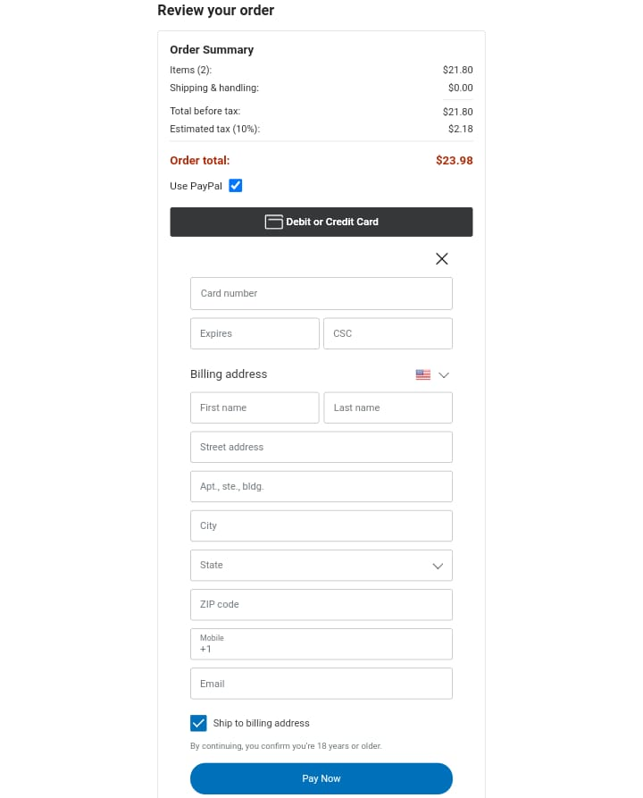
CHECKOUT
PAYMENT

Slide 10
Advantages
1.Familiarity: Users are already accustomed to Amazon's interface and features, so an Amazon clone app provides a familiar and user-friendly experience.
2. Convenient Shopping Experience: With features such as one-click ordering, personalized recommendations, and easy navigation, the clone app makes shopping quick and convenient.
3. Fast Delivery: Utilizing efficient logistics and delivery systems similar to Amazon, the clone app can offer fast and reliable shipping options to customers.
4. Secure Transactions: Just like Amazon, the clone app ensures secure payment processing and protects users' financial information, enhancing trust and confidence in the platform.
5. Seller Opportunities: The clone app provides a platform for third-party sellers to reach a wide audience, fostering competition and offering users a diverse range of products.

Slide 11
Conclusion
In conclusion, the development of our Amazon clone app using HTML, CSS, and JavaScript has been a remarkable journey towards creating a seamless online shopping experience. Through meticulous design and coding, we've successfully replicated key features of the original platform, offering users a familiar interface with added flexibility and customization.
The app's user-friendly layout ensures effortless navigation, allowing customers to browse through a vast array of products with ease. Our attention to detail in styling and responsiveness ensures a consistent and visually appealing experience across devices, enhancing accessibility for all users.
By leveraging JavaScript for dynamic functionalities, such as interactive product previews and real-time updates on cart items, we've elevated the shopping experience to a new level of interactivity and engagement.
Furthermore, the integration of secure payment gateways ensures transactions are conducted seamlessly and with peace of mind, fostering trust and confidence among users.
As we conclude this project, we reflect on the valuable lessons learned and the skills honed throughout the development process. Our Amazon clone app stands as a testament to our dedication to innovation and excellence in web development.
Moving forward, we envision continuous improvements and enhancements to further refine the app's performance and user experience. With a solid foundation in place, we are poised to adapt to evolving technologies and user needs, ensuring our Amazon clone app remains a leading choice in the ever-expanding world of online shopping.

Slide 12
Thank you !!

